Slide 1
Projekt im Bachelor: MAPC
5. Milestone
Team: JNY Nader Jawhary, Yamen Sahyouni, Joakim Vik Haukedal
17.02.2022
Notes:
1

Slide 2
Brief Overview
Milestone 5 overview
Example
Agent Structure
Strategy
Main Challenges
Problems
Solutions

Slide 3
Milestone 5 Overview
Solve obstacle avoiding problem
Further optimization
Shared communication
Meeting-points
Multi-block-task

Slide 4
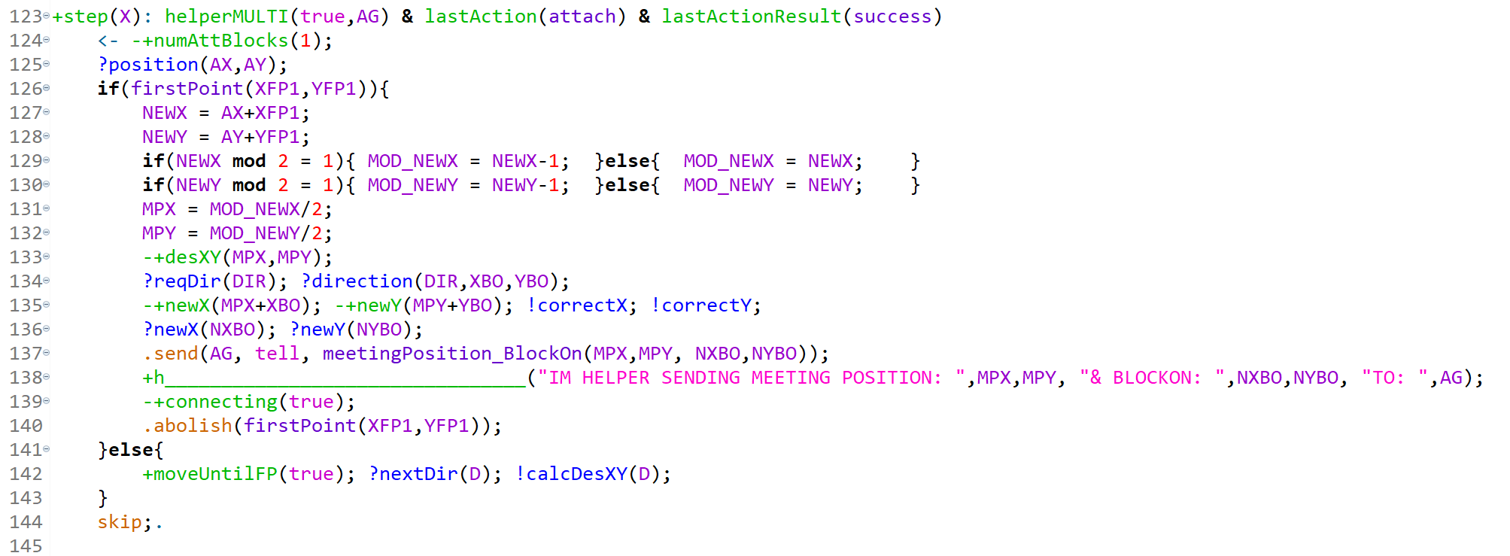
Code

Slide 5
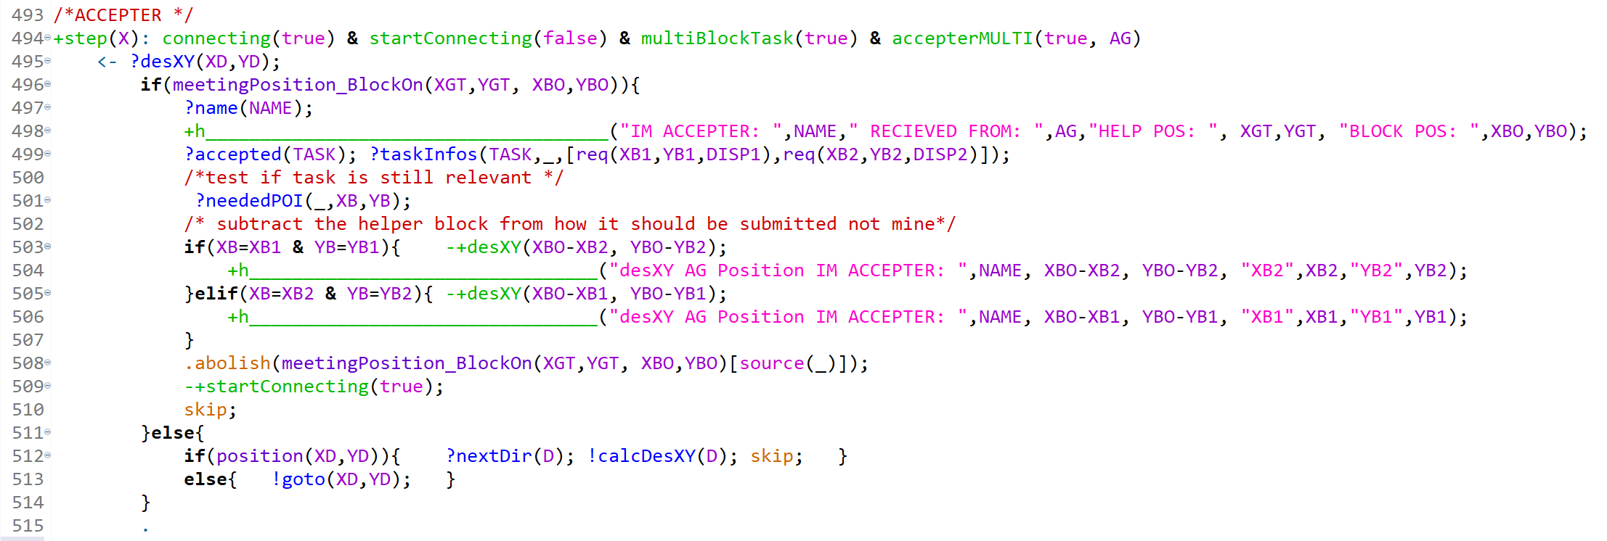
Code

Slide 6
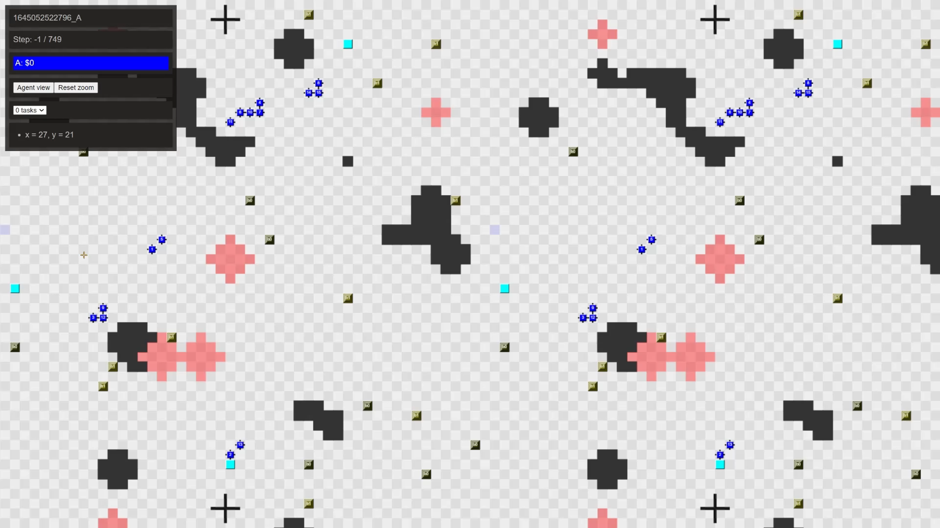
Video

Slide 7
Agent Structure
Agent searches
Gather POIs
Find taskboard or receive taskboard coordinates
Communication with other agents
Accept task
Solve task
Find helper if multi-block-task
Repeat

Slide 8
Strategy
Spiral movement
Log POIs on the belief-base
Clear obstacles
Multi block task
Accepter & helper
Meeting point

Slide 9
Main Challenges
Programming language
Concept learning and understanding
Error-messages
basic debug mode/Errors not detailed enough
Obstacles / agent collision
Tried: virtual sensors around the agent, to detect then avoid Obs/Ags
Source of no_action
Notes:
Error messages, solved with extra beliefs as debug-system

Slide 10
Problems
Avoiding obstacles using virtual sensors
Lead to communication problems with multi block tasks
no_action
Not found all sources of the problems
Meeting point
Tried: Wait by dispenser
Tried: Wait by goal
Optimization never finishes!
Notes:
Optimization, leads to further problem

Slide 11
Solutions
Clear obstacles, instead of avoiding
Based on lastAction(failed_path), clear
no_action
Tried: Putting upper limit on amount of times NoAction
Dream solution: find all no_action causes
Meeting point
Meet Halfway between dispensers
Our new method of debugging
Add beliefs in a plan to test if the plan was executed
Notes:
NoAction not solved

Slide 12
Future plans

